Slide 1


How to really use Google Gemini Advanced

Slide 2

"Google Gemini seems to have by many measures matched (or slightly exceeded) GPT-4, but not to have blown it away."
- Gary Marcus
Notes:
https://twitter.com/GaryMarcus/status/1732420151734321334

Slide 3

Getting Google Gemini Advanced

Slide 4
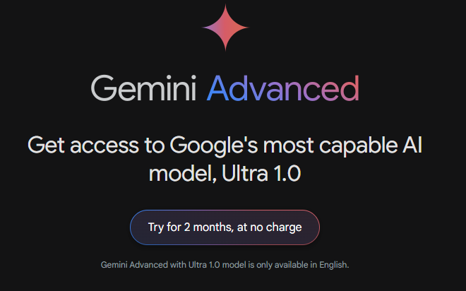
Gemini Ultra 1.0
Notes:
https://gemini.google.com/advanced

Slide 5
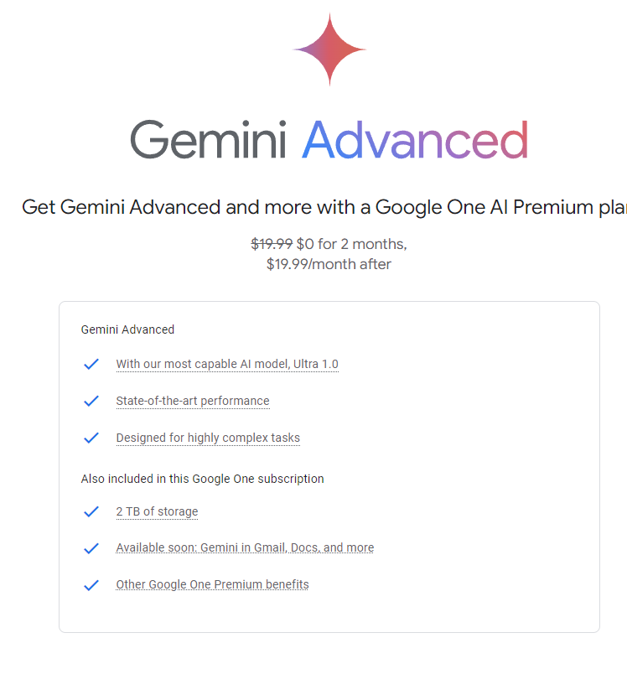
Google One AI Premium

Slide 6
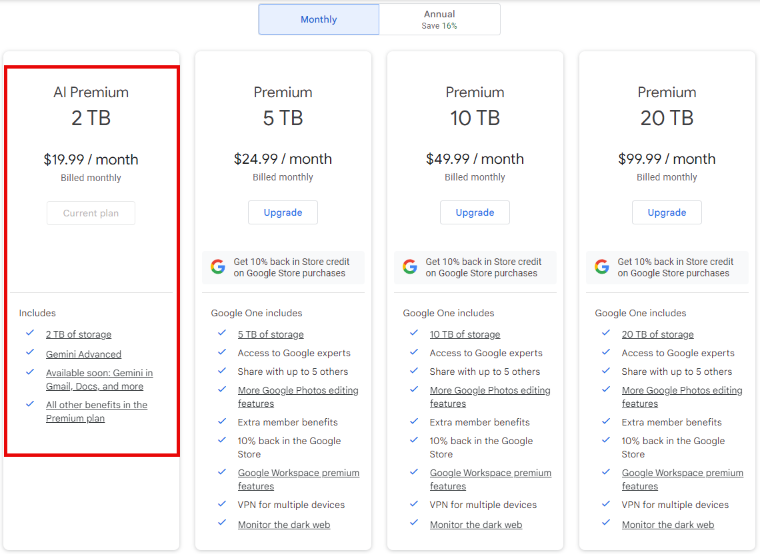
pricing

Slide 7
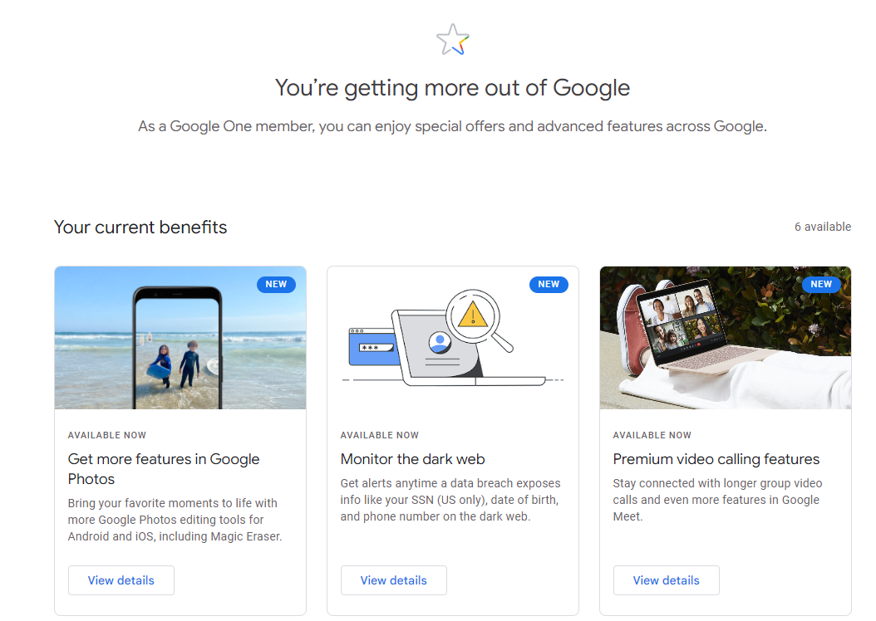
Notes:
https://one.google.com/benefits

Slide 8
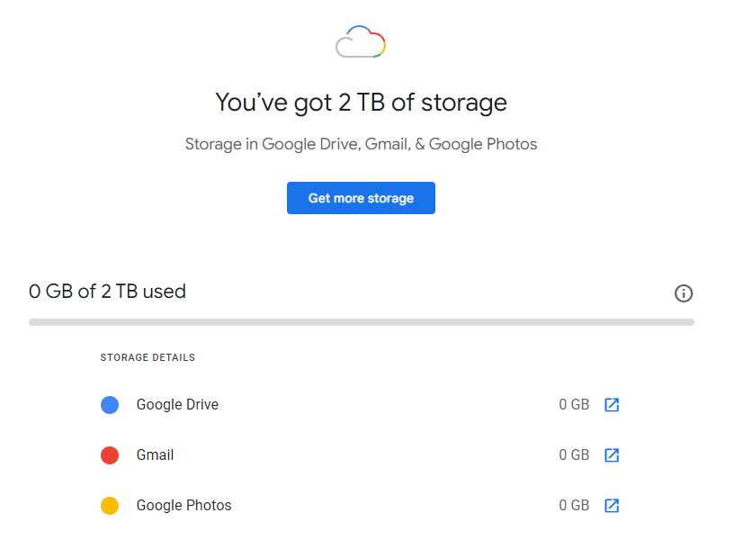
Notes:
https://one.google.com/storage

Slide 9
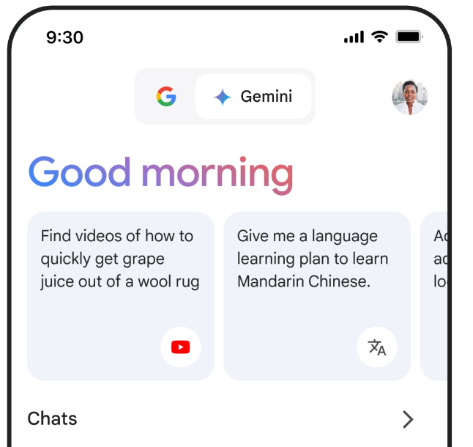
Use the website, Get the mobile App
Notes:
https://blog.google/products/gemini/bard-gemini-advanced-app/

Slide 10

Why Google Gemini Advanced?

Slide 11
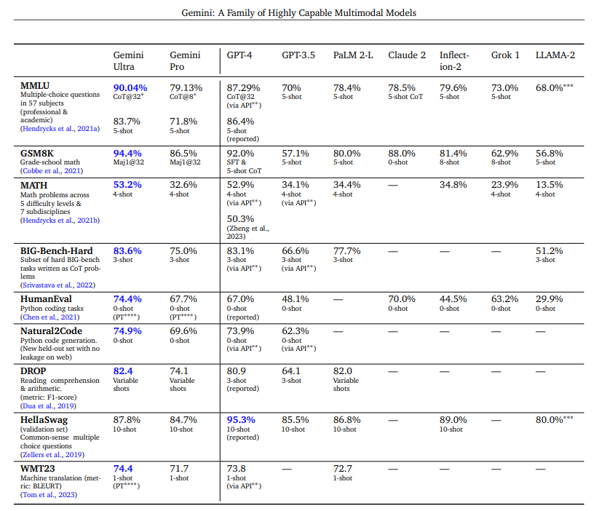
Better than ChatGPT?

Slide 12
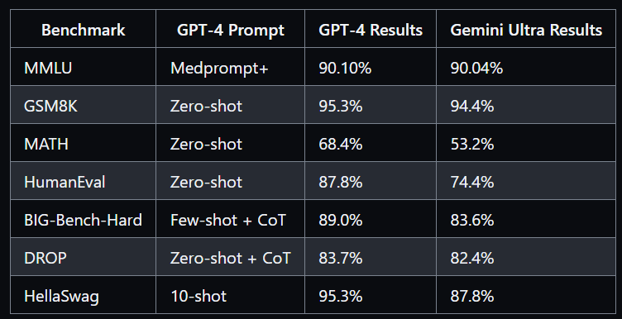
The Jury is Still Out
Notes:
https://github.com/microsoft/promptbase

Slide 13

Exploring the interface

Slide 14

speed
Notes:
Give me a 500 word essay on space-time

Slide 15

Text
Notes:
Create a story about an astronaut who travels to mars, and the year is 2030. Be creative and feel free to add fun/special twists. Make sure the story isn’t more than 200 words.
Explain black holes to me like I was in kindergarten
No you asshole, I meant for you to do this other thing

Slide 16

Vision

Slide 17

Identification

Slide 18
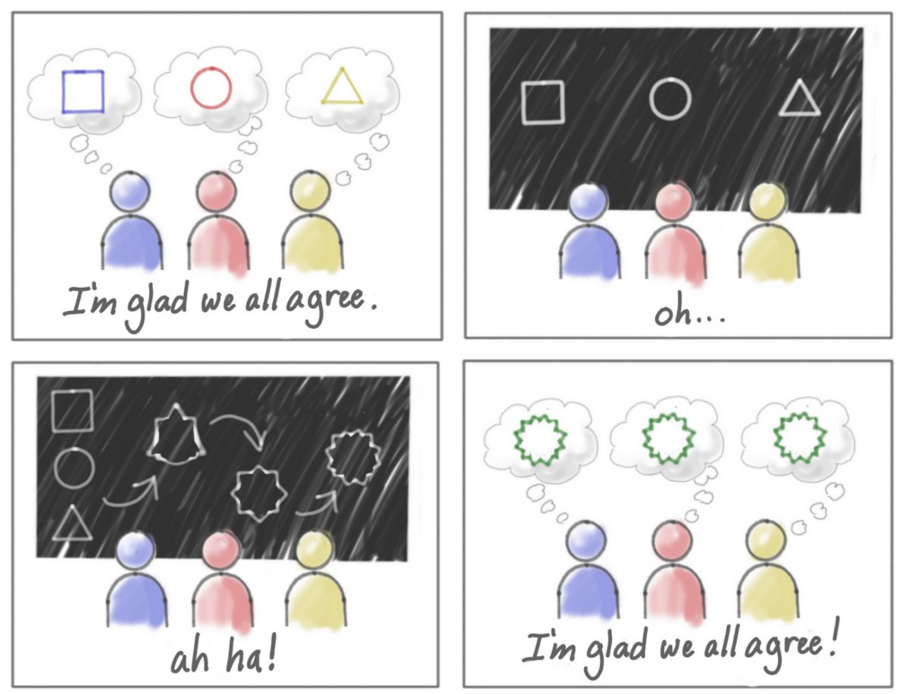
Abstract Ideas

Slide 19

Medical

Slide 20
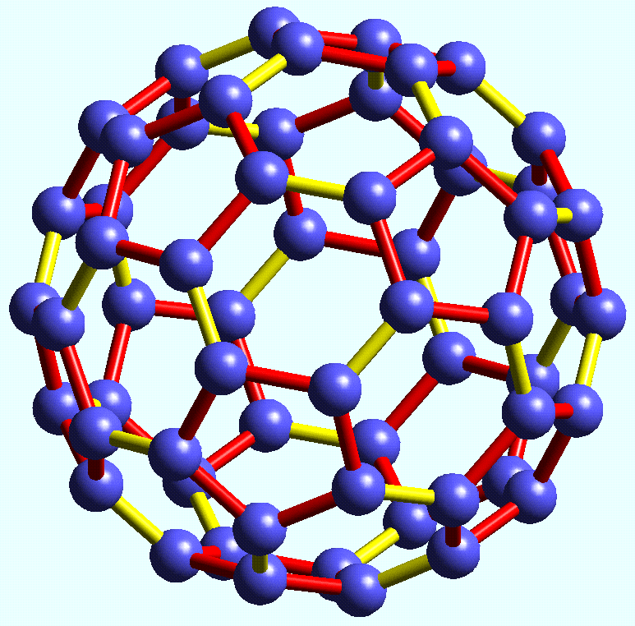
Chemistry

Slide 21
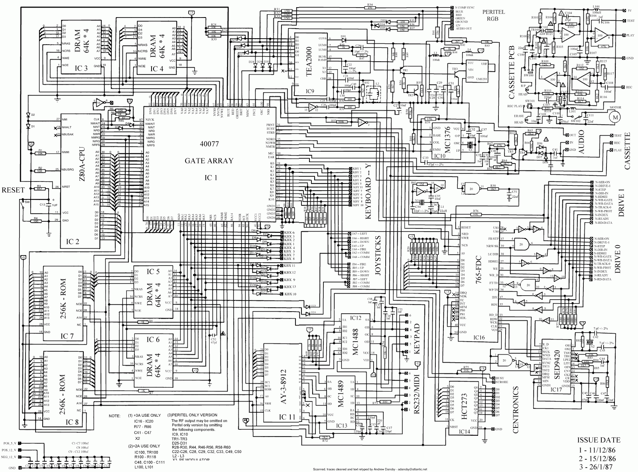
Electronics

Slide 22
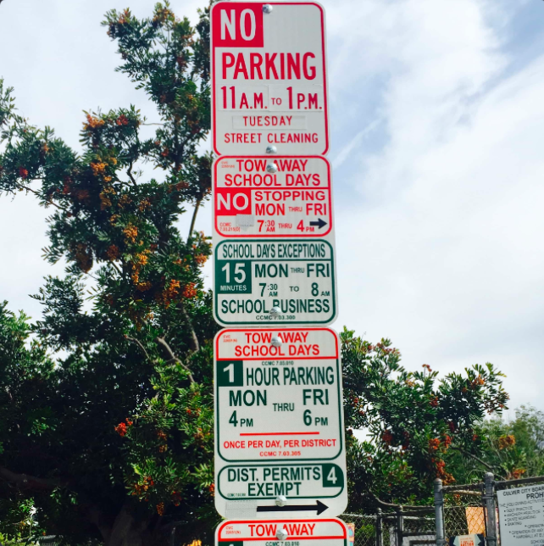
Parking

Slide 23
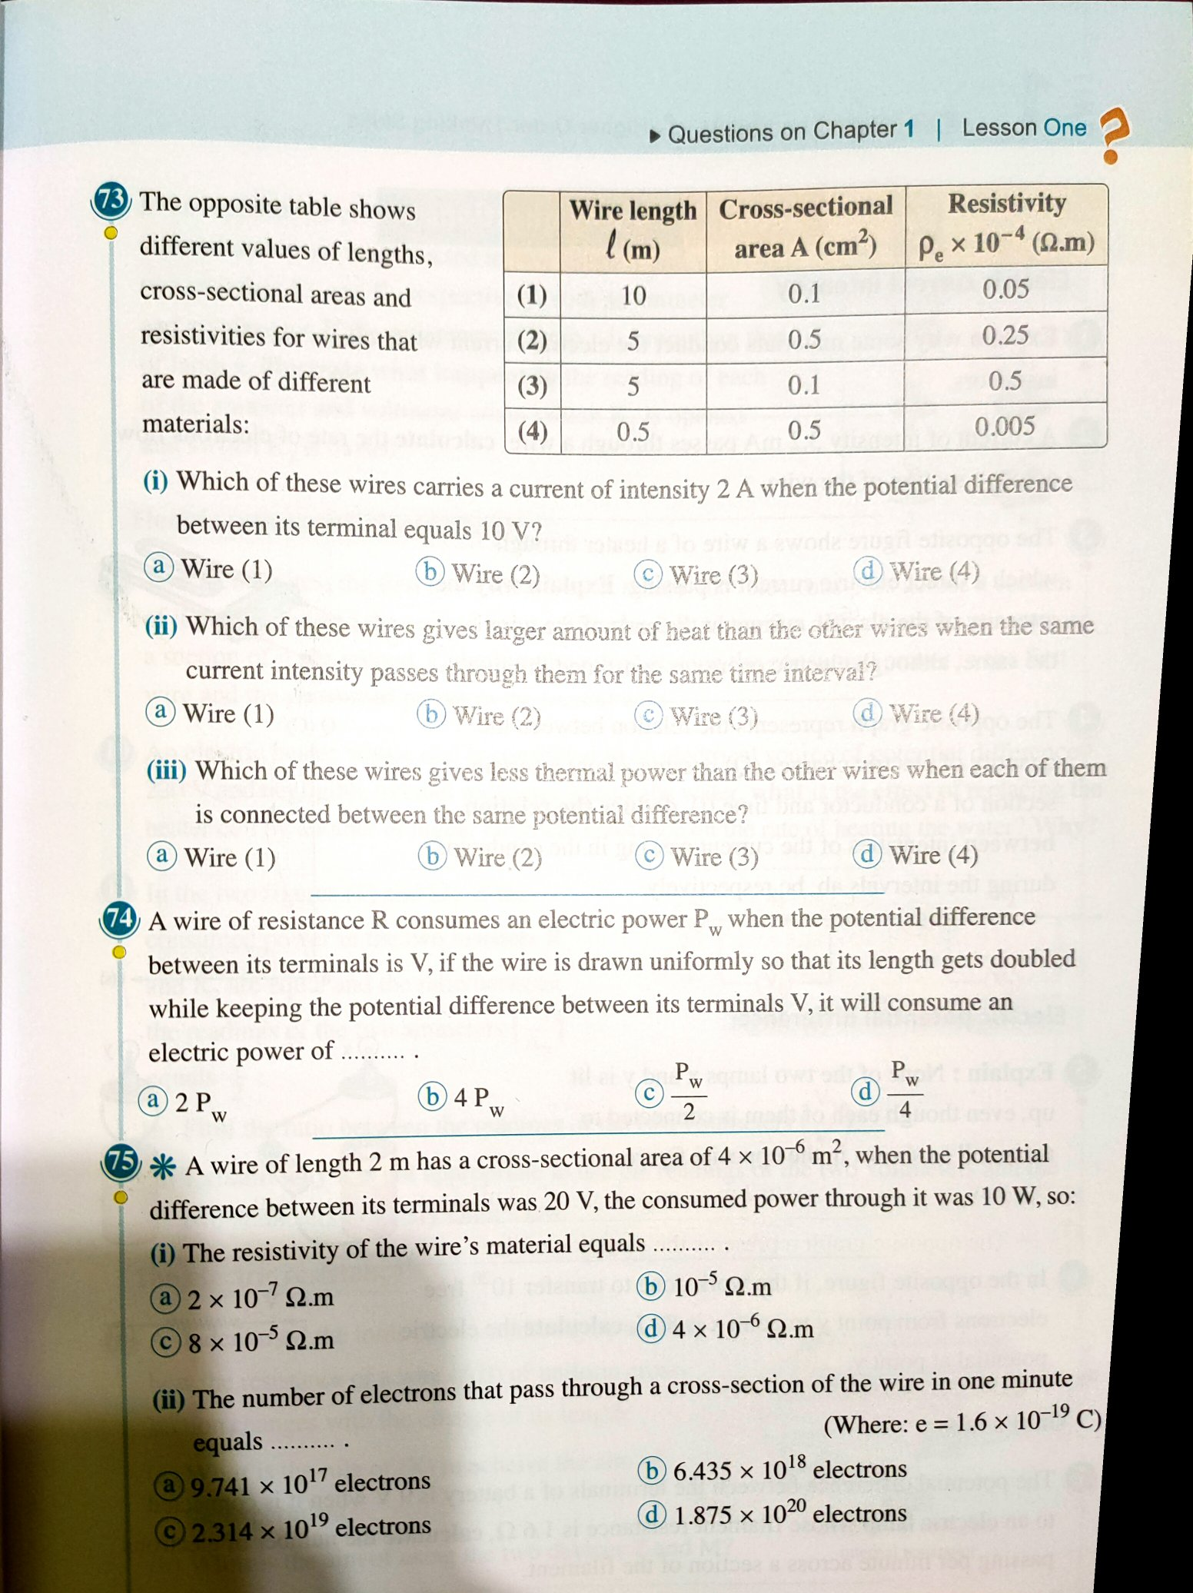
Homework

Slide 24
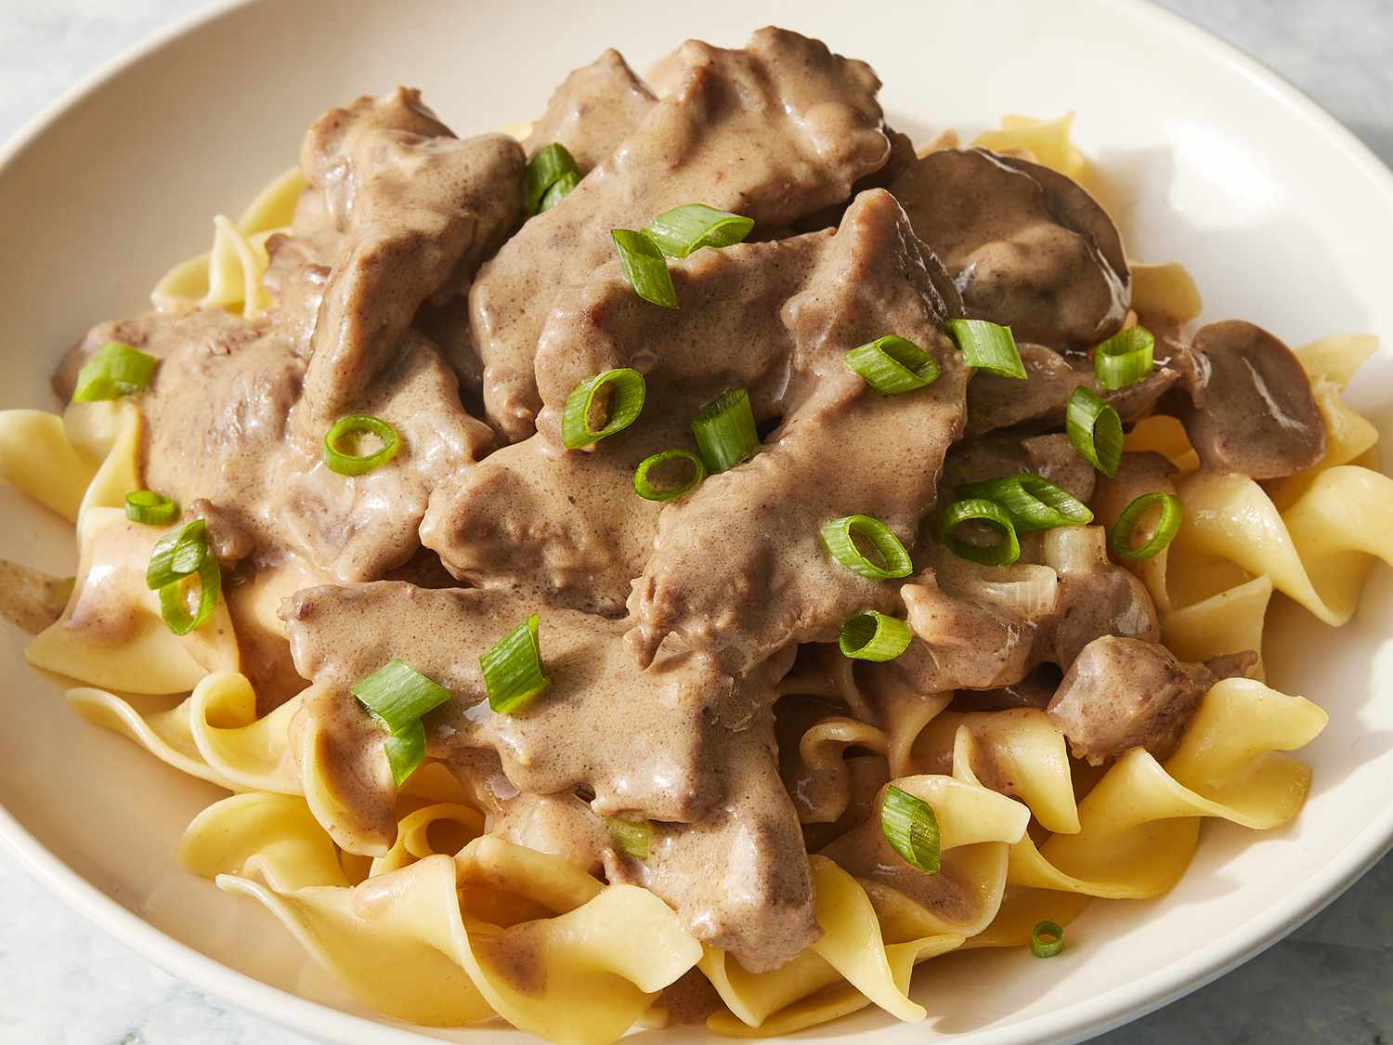
Cooking

Slide 25

Poker

Slide 26
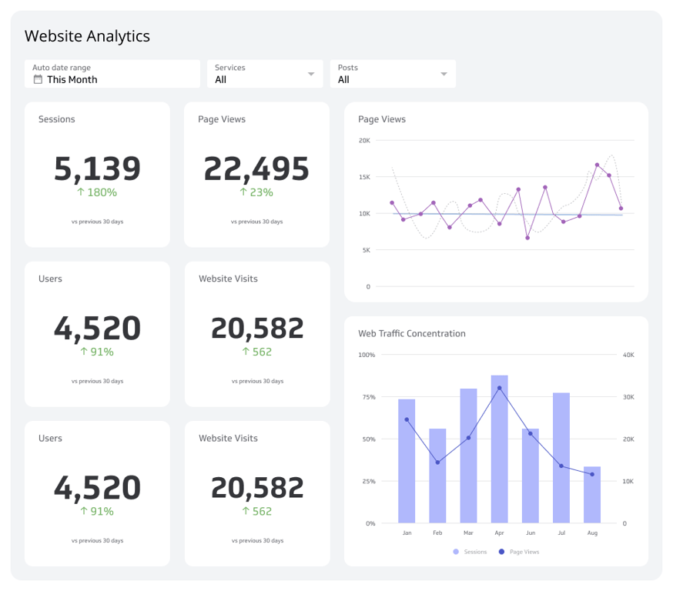
Code

Slide 27

Browsing
Notes:
Search the web for gemini ultra best prompts
Search the web for the best beer rankings

Slide 28

Image Generation
Notes:
Create a landscape view image of what I would see if I were looking at Earth from the surface of Mars.
Create an image of a dystopian cityscape with the word “Dystopian” written big and floating in the sky.

Slide 29

Data Analysis
Notes:
Get the penguin dataset and do a full data analysis of the data with all visuals possible.
Look at this data and do a full data analysis with all data possible.

Slide 30
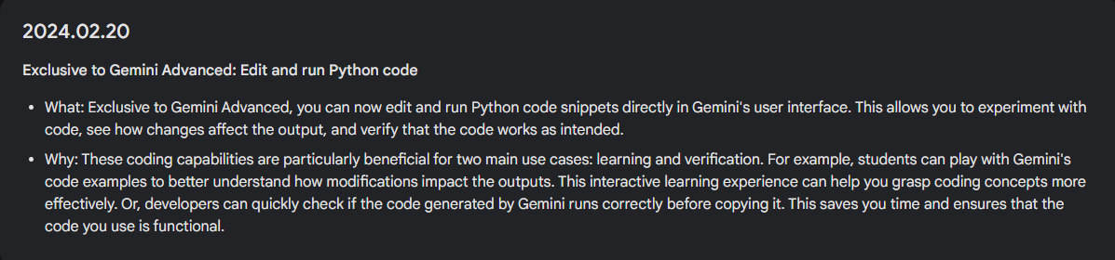
Rapidly Changing landscape

Slide 31
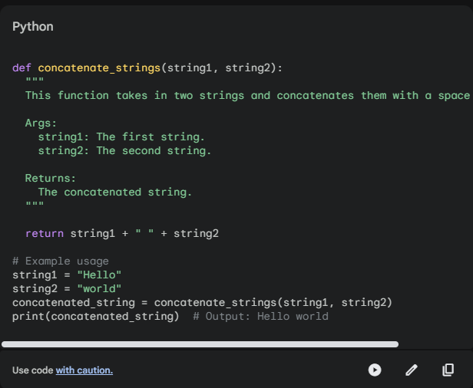
Python in Gemini

Slide 32
packages
IPython, PIL, __future__, __hello__, __main__, _aix_support, _bootsubprocess, _collections_abc, _compat_pickle, _compression, _markupbase, _osx_support, _py_abc, _pydecimal, _pyio, _sitebuiltins, _strptime, _sysconfigdata__darwin_x86_64-darwin, _sysconfigdata__linux_aarch64-linux-gnu, _sysconfigdata__linux_x86_64-linux-gnu, _threading_local, _weakrefset, abc, absl, aifc, altair, antigravity, apipkg, appdirs, argparse, ast, async_sandbox_rpc, asynchat, asyncio, asyncore, attr, attrs, base64, bdb, bisect, blaze_compatibility_hack, bz2, cProfile, calendar, cgi, cgitb, charts_json_writer, chess, chunk, cmd, code, codecs, codeop, collections, colorsys, compileall, concurrent, configparser, contextlib, contextvars, contourpy, copy, copyreg, crypt, cssselect, csv, ctypes, curses, cv2, cycler, dataclasses, datetime, dateutil, dbm, decimal, decorator, defusedxml, difflib, dis, distutils, doctest, email, encodings, entrypoints, enum, et_xmlfile, filecmp, fileinput, fnmatch, fontTools, format_exception, fractions, fs, ftplib, functools, future, genericpath, getopt, getpass, gettext, glob, gmpy2, google, google3, graphlib, gzip, hashlib, heapq, hmac, html, http, husl, imaplib, imghdr, imp, importlib, iniconfig, inspect, io, ipaddress, jaraco, jinja2, joblib, json, jsonschema, keyword, kiwisolver, lib2to3, libfuturize, libpasteurize, linecache, locale, logging, lxml, lzma, mailbox, mailcap, markupsafe, matplotlib, matplotlib_post_processor, mimetypes, modulefinder, more_itertools, mpl_toolkits, mpmath, multiprocessing, netrc, nntplib, ntpath, nturl2path, numbers, numexpr, numpy, opcode, openpyxl, operator, optparse, os, packaging, pandas, past, pathlib, patsy, pdb, pexpect, pickle, pickletools, pipes, pkg_resources, pkgutil, platform, platformdirs, plistlib, poplib, posixpath, pprint, profile, pstats, psutil, pty, ptyprocess, py, py_compile, py_interpreter, py_interpreter_blaze, pyclbr, pydoc, pydoc_data, pydot, pyglet, pyparsing, pyrsistent, pytz, queue, quopri, random, re, reprlib, rlcompleter, runpy, sandbox_rpc, sandbox_rpc_pb2, sched, scipy, seaborn, secrets, selectors, shelve, shlex, shutil, signal, site, six, sklearn, smtpd, smtplib, sndhdr, socket, socketserver, sqlite3, sre_compile, sre_constants, sre_parse, ssl, stat, statistics, statsmodels, string, stringprep, striprtf, struct, subprocess, sunau, sympy, symtable, sysconfig, tables, tabnanny, tarfile, telnetlib, tempfile, textwrap, theano, this, threading, threadpoolctl, timeit, tkinter, token, tokenize, tomllib, toolz, tornado, trace, traceback, tracemalloc, tty, turtle, types, typing, uharfbuzz, unittest, urllib, uu, uuid, vega_datasets, venv, warnings, wave, weakref, webbrowser, wsgiref, xdrlib, xlrd, xml, xmlrpc, zipapp, zipfile, zipimport, zmq, zoneinfo

Slide 33

Extensions
Notes:
https://gemini.google.com/extensions
@Google Drive summarize all the AI articles

Slide 34


